Slide 1
Setting
Reading Comprehension

Slide 2
What is the Setting?
The time and place where a story happens
Why is it important to know?
Knowing the setting helps you visualize the text
Setting effects the development of the plot

Slide 3
How to Determine the Setting
The narrator may tell you exactly when and where the story are taking place
However, Sometimes you may have to determine the setting based on clues
If the exact date is not listed, it is good enough to say something like modern times PRESENT, in the recent PAST, in the distant PAST, in the distant FUTURE, etc.

Slide 4
Example One:
Jake hopped on his horse and trotted around the stables. He looked around the range from his mount and considered going on a ride through the prairie. He decided against it. Then he heard a train whistle in the distance. This was it. More settlers have arrived. Now Jake would take some of the weaker horses to the station and sell them to the new folks, who were horseless.
When and where did this story take place?

Slide 5
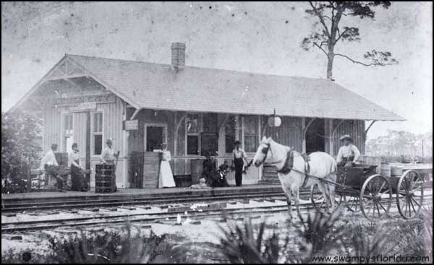
Suggested Answer
The story is taking place in the past, perhaps the late 1800’s, on a ranch near a train station.
Explanation
I believe this because the train whistles seems important to Jake. There are no cars and Jake is selling horses.

Slide 6
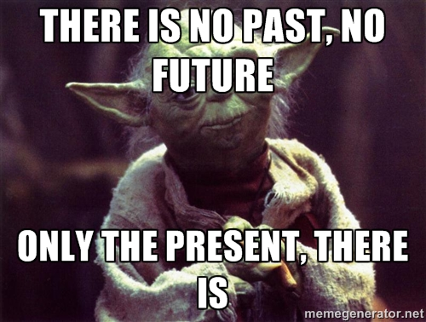
Review
The setting is the time and place
If it isn’t clearly stated, look for clues as to where and when the story is happening.
Saying things like, modern times, the recent past, and the distant past will work if the date isn’t clearly stated.

Slide 7
Ok- Let’s Practice
Guess the setting from the passage

Slide 8
Practice
You Will Need Out:
Steps To Follow:
A blank sheet of lined paper
Something to write with
Read the passage
Write the setting- look for clues!
Explain your answer

Slide 9
Passage One
Dirk adjusted his space suit. He wasn’t used to fighting aliens in zero gravity. He was more of a terrain fighter. He looked around the spaceship. Three Zorlak warriors were splattered against the wall. He pressed the communi-button. A second later, a voice spoke into the cabin. “Commander Dirk, how may I support you?” Dirk smiled and replied, “We need someone to come clean up an awful mess in here. I’m in the control chamber by the engine room.”

Slide 10
Suggested Answer
This story is taking place on a spaceship in the distant future.
Explanation
I believe this because there is advanced technology and they are in a spaceship.

Slide 11
Passage Two
Orlak pulled Gorth near the fire. He wrapped his arm around him and spoke from his heart, “Orlak need mammoth fur. Orlak too cold in cave.” Gorth grunted and looked around the cave walls. Gorth remembered what it was like sleeping in a cave before he had a mammoth fur. He spoke to Orlak, “OK, Orlak. We get you fur.” A cold wind blew through the cave.

Slide 12
Suggested Answer
This story is taking place in the distant past in a cave.
Explanation
I believe this because the characters appear to be cavemen plotting to acquire mammoth furs.

Slide 13
Passage Three
Chuck kicked the basketball. It bounced off the wrestling mats on the wall of the gymnasium with a thud. There was no one around to get offended by his behavior. He crumpled up his progress report and threw it into the bleachers. He screamed, “Ahh! All I wanted to do was play in that game! This is so unfair.” He was miserable and sweating. His phone started ringing in his pocket.

Slide 14
Suggested Answer
This story is taking place during modern times in a gym.
Explanation
I believe this because Chuck is in a gym and he has a phone.

Slide 15
Now let’s try with something familiar…
The train went to a large, seven-story high building supported by magic, with a hundred and forty two staircases throughout its many towers, turrets and very deep dungeons. The castle was built in the late Early Middle Ages by a wizard architect and the four most celebrated wizards of the age: Godric Gryffindor, Helga Hufflepuff, Rowena Ravenclaw and Salazar Slytherin. It is regarded as the finest wizarding school in the world. It is said that, “The castle is a strong hold of ancient magic.”

Slide 16
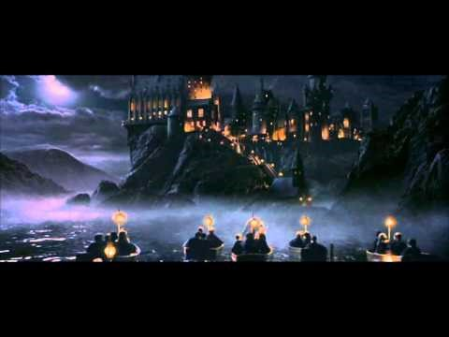
The Answer:
Hogwarts School of Witchcraft and Wizardry

Slide 17
Let’s try again…
She sat against the edge of an old space carrier that she had fixed into a temporary home. It was empty and full of scraps, just like this planet. As she put on the old helmet, the only clue remaining of her family, she looked out into the dessert horizon and watched the two suns set. Jakku, her planet, had become a junk yard. A junkyard full of traders and thieves. Rey sat in her planet’s sandy ground eating the last bit of food that she had. Just then, she heard a beeping sound in the distance. A trader? A droid? She ran around the piece-of-garbage ship to see a BB unit stuck in the net of a sand person, ready to be traded.

Slide 18

The Answer:
Star Wars: The Force Awakens

Slide 19
OK- last time ☺
Suddenly, she felt the platform lift. Her heart began to race and fear surrounded her. How did she end up back here? For the second time? The platform lifted out of the darkness and she was blinded by sunlight. Everything was moving so fast. She could see herself surrounded by water. Each victor had their own path. Trees and plants were nearby, but all she could see was water. She looked to her left and could see Peeta. They were back in the arena. She looked around to see what she could find. The island was in the center. She would have to swim there to find a weapon. Just then she heard the alarm and a faceless voice say, “May the odds be ever in your favor.”

Slide 20
The Answer:
The Hunger Games: Catching Fire

